Slide 1


City DATE
Playing
DALI
Put your LOGO here
Location
Date

Slide 2

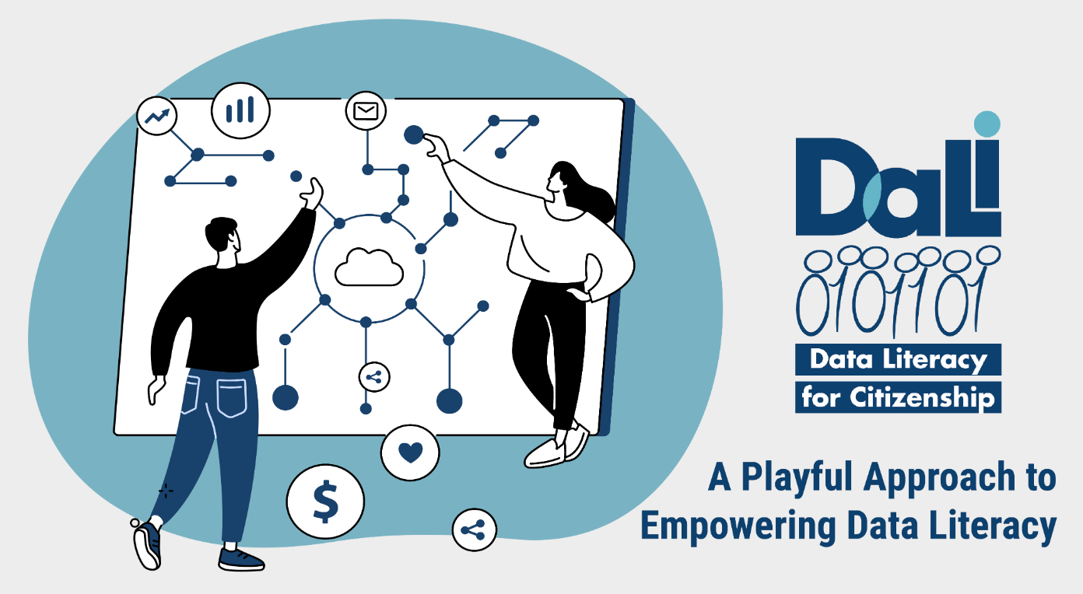





Slide 3

Notes:
Dali is aimed at promoting citizens’ data literacy with a playful approach

Slide 4
Notes:
Dali is aimed at promoting citizens’ data literacy with a playful approach

Slide 5
What do you know about your data?

Slide 6


Slide 7

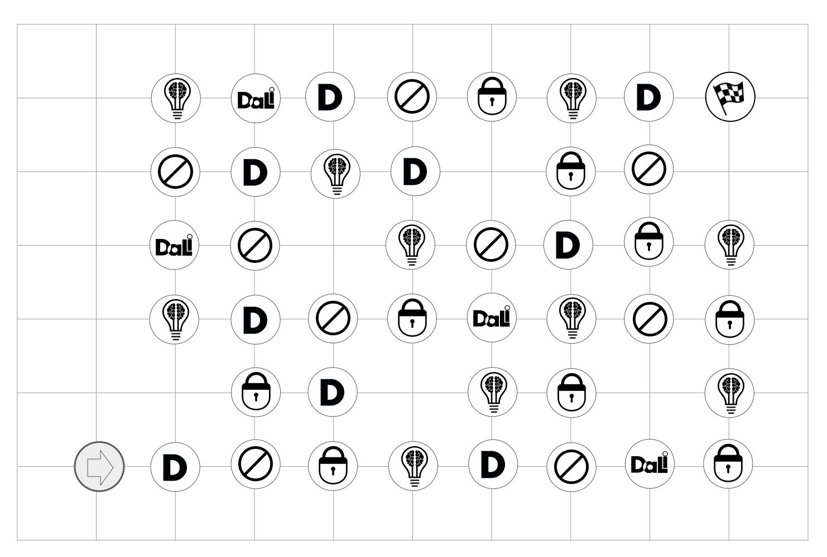


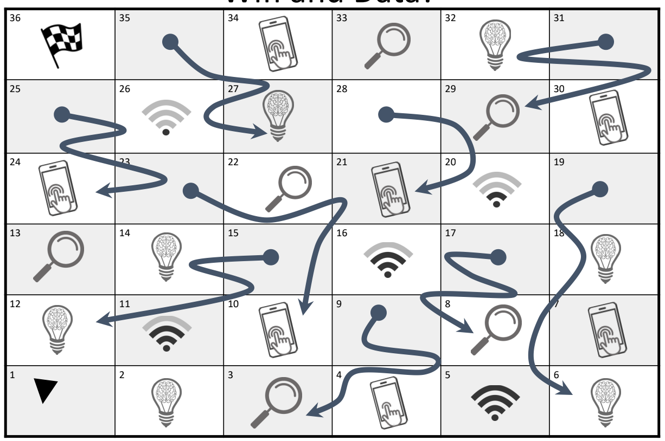
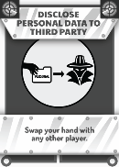
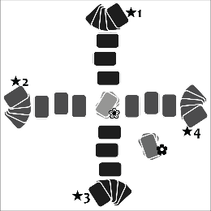
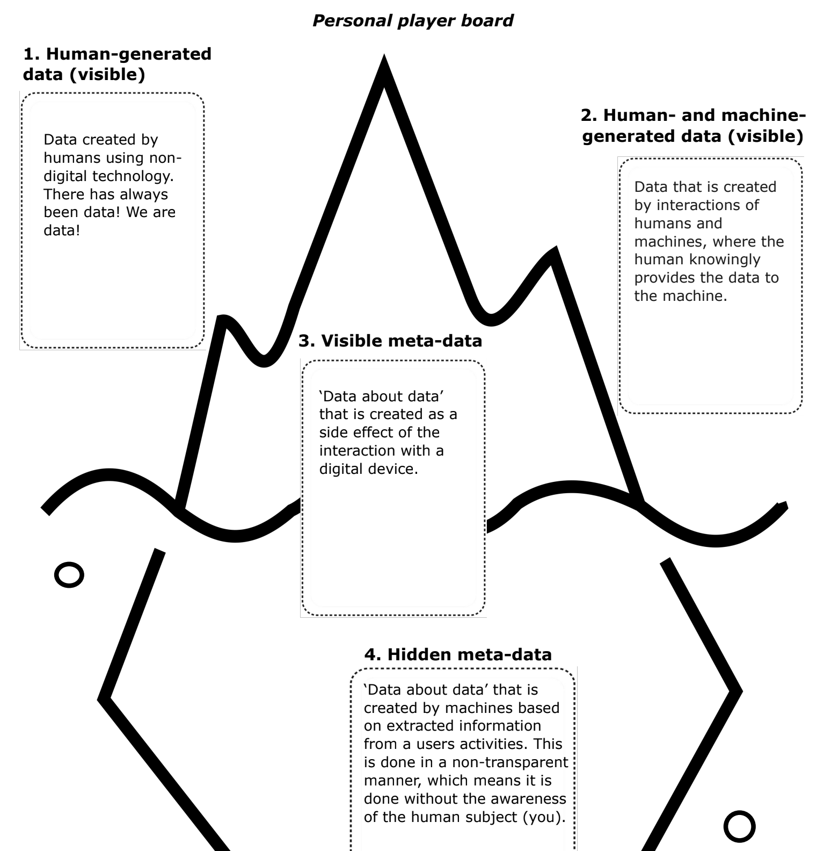
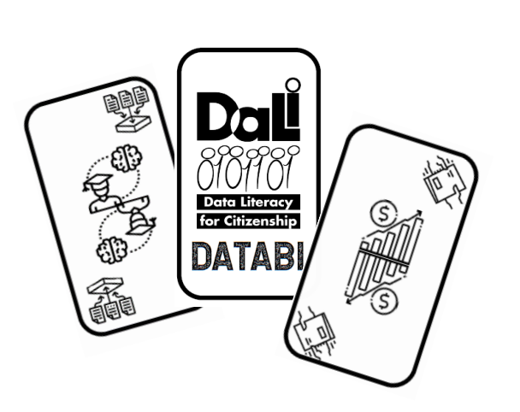
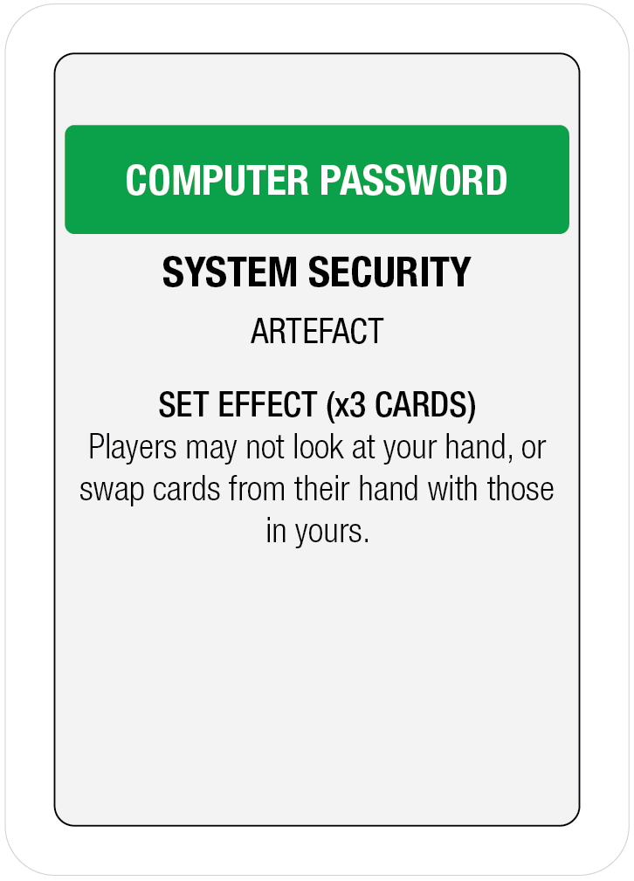
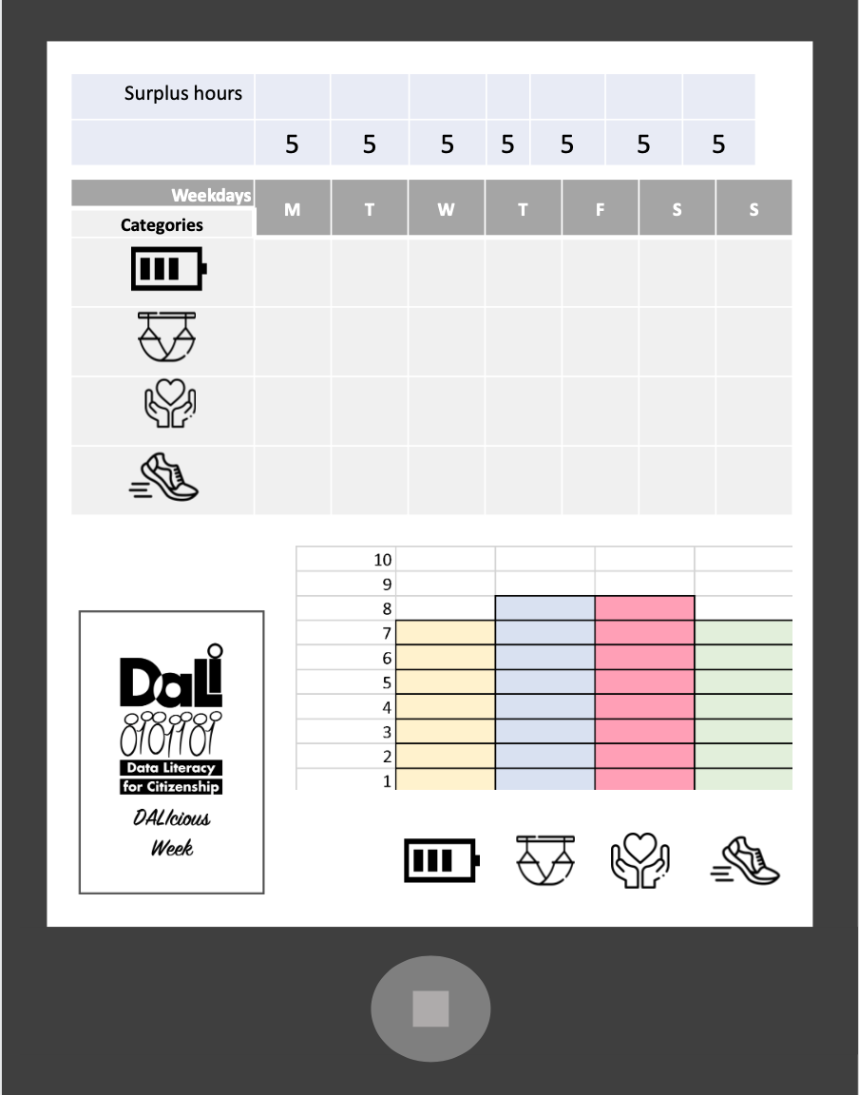


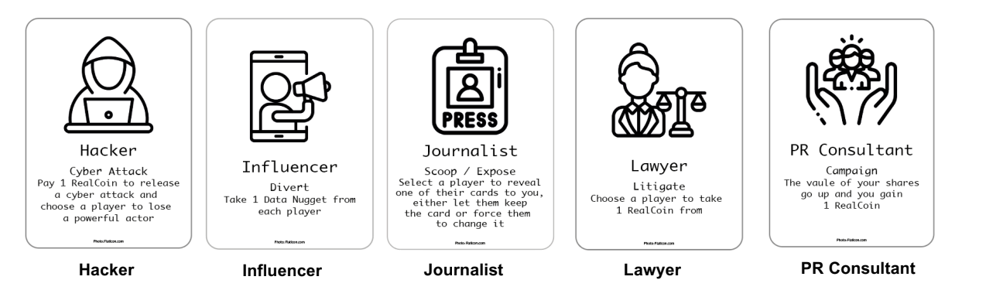
What games?

Slide 8



Dali Life
Being aware / knowing about the existence of data
An educational game mixing event and action cards for a race to the finish line
The winner of the game is the first person to reach the circle marked ‘FINISH’

Slide 9

Daliopoly
Understanding how society shapes data use and influences policymaking
A data-themed tactical card game featuring artefact and action cards
The winner of the game is the first player with 3 sets

Slide 10
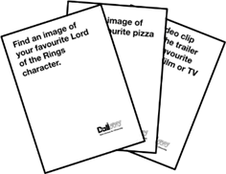
Game of phones
Sharing and communicating data sets that already exist under ethical considerations
Browse the web quickly to find the result that fits best the
description of the card
The player who won the most amount of rounds wins the game

Slide 11
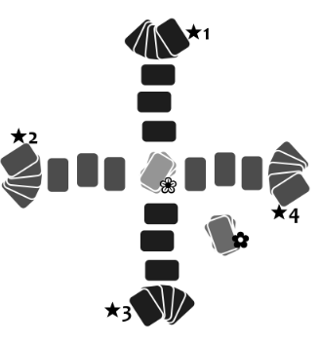
Data chain
Understanding data activism movements and how these can change stakeholder’s use of data.
Players take the roles of data activists and data brokers. Inspired by Magic the Gathering
Once a chain of 6 cards has been formed between two teammates, they are declared the winners and the game ends.

Slide 12
Data Takeover
Knowing that data have a value;
Knowing data can be used for multiple purposes
The game features bluffing as a core game mechanic
A player wins when all opponents have lost all their Powerful Actors cards.

Slide 13
Where is Data in your Story?
Understanding civil action; individual potential to use data
Using the illustrations on the cards, invent a story featuring the card elements and data creation in one’s everyday life
The narrative that gets the most votes wins the round. After three rounds the winner of the game is announced: the one who won the most rounds, wins.

Slide 14
Wifi and Data!
Being aware / knowing about the existence of data
An adaption of the board game Snakes and Ladders with trivia questions about data
The first player whose figure reaches the finish line (position 36) wins the game.

Slide 15
Data Iceberg
Understanding what data is and how it is created
A memory game featuring different data types and corresponding examples for players to guess
The one with the most pairs of matching
cards on the right part of the personal game board wins.

Slide 16
Protearn your data
Using external devices/apps to collect data.
By going through the board, the player will be collecting data (cards with data icon) on which 3 actions can be carried out
The first player who arrives at the final box (with a flag) STOPS the game. The winner is the one with the most data protected (data cards covered with lock cards) and with the most data cards covered with learning card (the bulb icon card).

Slide 17
Dalicious week
Creating, editing and storing data in simple file formats (.txt or .xsl).
The main goal is to achieve your "ideal week" by efficiently organising your schedule and engaging in activities related to energy, rest, exercise, and love.
The person who reaches his/her ideal week is the winner (or the one who is the nearest after 7 rounds)

Slide 18
DATABI
Understanding your influence on peers or stakeholders; helping them understand the potential and applications of data
DATABI is a cooperative game, which means all players are on the same team.
You all have completed all the categories... Winners!

Slide 19
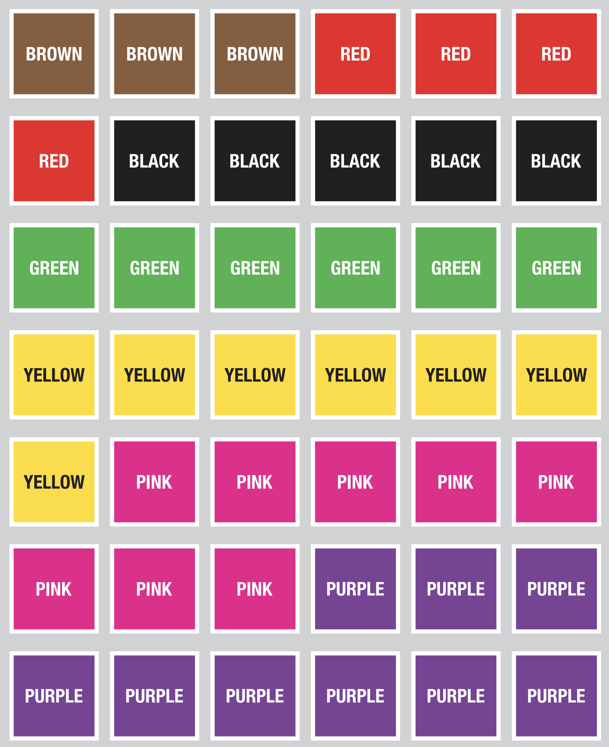
Dali Escape Room
Understanding your influence on peers or stakeholders; helping them understand the potential and applications of data
A team-based game with 9 interlocking puzzles
The players must complete the game within an allotted time frame

Slide 20
5 online minigames

Slide 21

Organization of the players and groups
Notes:
https://cdn.pixabay.com/photo/2018/03/21/06/30/community-3245739_1280.png

Slide 22

Time to play

Slide 23

Time to
finish

Slide 24
What have you learnt?

Slide 25

Framework
Acting on data
Actions to be carried out materially or technically
Managing
Data
Sharing
Data
Artefacts
Collecting
Data
Understanding data
Engaging through data
Mental operations, reflections
and processes that do not imply necessarily actions
Actions that affect individuals and the world
Knowledge
Awareness
Critical
Thinking
Policy and
Regulation
Taking
Decisions
Data
Activism
Data
Advocacy
Ethics & Privacy

Slide 26

Thank you!

Slide 27

Time to
give your feedback

Slide 28
Thank you!

Slide 29


Put your LOGO here
https://dalicitizens.eu/
https://toolkit.dalicitizens.eu/
Location
Date

